Slide 1
% python3
Python 3.12.10 (main, Apr 12 2025, 04:06:31) [Clang 15.0.0 (clang-1500.3.9.4)] on darwin
Type "help", "copyright", "credits" or "license" for more information.
>>> import pya
>>> pya.Trans(45, False, 0, 0) --- (1)
r90 0,0
>>> pya.Trans(45, True, 0, 0) --- (2)
m45 0,0
>>> pya.CplxTrans(1, 45, False, 0, 0) --- (3)
r45 *1 0,0
>>> pya.CplxTrans(1, 45, True, 0, 0) --- (4)
m22.5 *1 0,0
>>>
These are all correct!

Slide 2
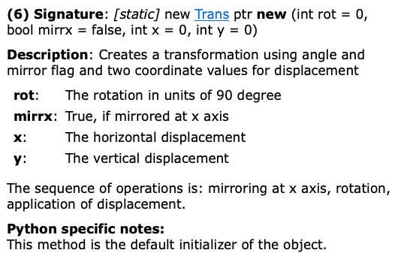
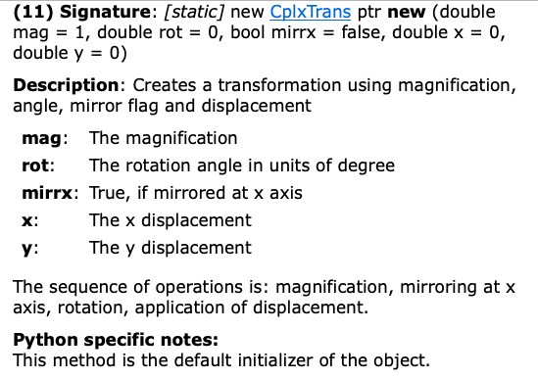
class Trans
class CplxTrans
rot=45=45x90deg=(4x11+1)x90deg
=(11x360deg)+90deg=90deg
rot=45=45deg

Slide 3
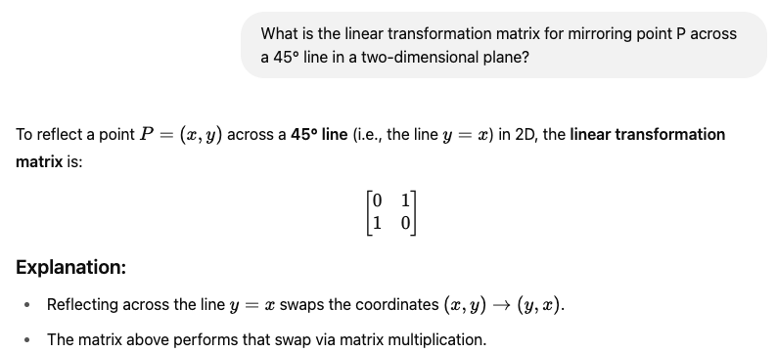

>>> pya.Trans(45, False, 0, 0) --- (1)
# No reflection wrt the X-axis followed by 90deg rotation, hence,
r90 0,0
>>> pya.Trans(45, True, 0, 0) --- (2)
# reflection wrt the X-axis followed by 90deg rotation, hence,
m45 0,0
Proof:
$R_{90}∙M_{x}=\left(\begin{matrix}\cos{90}° & −\sin{90°} \\ \sin{90}° & \cos{90}°\end{matrix}\right)\left(\begin{matrix}1 & 0 \\ 0 & −1\end{matrix}\right)=\left(\begin{matrix}0 & −1 \\ 1 & 0\end{matrix}\right)$ $\left(\begin{matrix}1 & 0 \\ 0 & −1\end{matrix}\right)$=$\left(\begin{matrix}0 & 1 \\ 1 & 0\end{matrix}\right)$

Slide 4
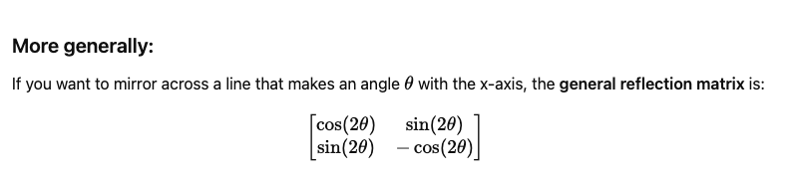

>>> pya.CplxTrans(1, 45, False, 0, 0) --- (3)
# No reflection wrt the X-axis followed by 45deg rotation, hence,
r45 *1 0,0
>>> pya.CplxTrans(1, 45, True, 0, 0) --- (4)
# reflection wrt the X-axis followed by 45deg rotation, hence,
m22.5 *1 0,0
Proof:
$$R_{45}∙M_{x}=\left(\begin{matrix}\cos{45}° & −\sin{45°} \\ \sin{45}° & \cos{45}°\end{matrix}\right)\left(\begin{matrix}1 & 0 \\ 0 & −1\end{matrix}\right)=\left(\begin{matrix}\cos{45}° & \sin{45}° \\ \sin{45}° & −cos{45°}\end{matrix}\right)$$
$if θ=22.5°$, they match

